Slide 1


5-Year Growth Strategy
Patrick Coffey
Implementation Plan - Group 40
STRATEGY 1: Internationalisation
China emerged the most attractive country from the decision matrix
Strengths and growth opportunities from SWOT and Pestle also saw China emerge as most attractive.
Lucrative market, opportunity to expand customer base, & diversify revenue streams.
ROI: €4 Billion
Strategic Partnerships, an acquisition, & introduction of new skin health product.
STRATEGY 2: Internal Diversity & Diverse Market Penetration
Ansoff Matrix: Market Penetration.
SWOT: Acquisition Capabilities & R&D Capabilities (S), Male Market (O), Imbalanced Product Offering (W), Competition (T), in line with Broad Differentiation Strategy.
ROI: over €1 billion
Advertising campaign, training programme, male rebranding & an acquisition.
STRATEGY 3: Customer Retention with Beauty Tech
Total Revenue Growth:
over €8.7 billion
(22.94% from 2022)
SWOT: Emerging Technology (O) & R&D Capabilities (S).
Broad Differentiation Strategy: Patent Portfolio.
Porter’s 5 Forces & Mature Industry Lifecycle: Customer Retention & Underserved Revenue Streams.
ROI: over €1.4 billion
Personalisation platform, an immersive training platform and a metaverse retail store.
Notes:
Introduction
Welcome we are Next Level Consultancy and today we will be presenting a five-year profitable growth strategy. We have developed 3 strategies with several implementation plans
ESG
As ESG is such an important topic in conducting business today, we have ensured that each strategy is aimed at increasing L’Oreal’s ESG rating.
Strategy 1
After conducting a decision matrix we recommend that L’Oreal strengthen their market presence in China. We also conducted a SWOT and Pestle analysis on China. The strengths and growth opportunities that emerged proved that China is the most attractive market for L’Oreal to expand their presence in.
Value - Strengthening operations in China allows L’Oréal to work within a lucrative market, expand its customer base, and diversify revenue streams.
We forecast that this strategy will generate a return on investment of approx €4 Billion
Our implementation strategies are: Forming Strategic partnerships an acquisition and a new product introduction.
Strategy 2 (ARIANNE)
We recommend L’Oréal enhance internal diversity and penetrate the male market, by implementing an advertising campaign, training, male rebranding & an acquisition.
By developing their human capital and leveraging their Capabilities they take advantage of the male market by improving their Product Offering and neutralise the threat of Competition.
We predict a ROI of over €1 billion euros.
Strategy 3 (ARIANNE)
We propose L’Oreal prioritise customer retention with Beauty Tech, by implementing Personalisation and training platforms, and a metaverse retail store
Emerging technology is a key opportunity and by using L'Oréal's capabilities, broad differentiation strategy and patent portfolio they can become a beauty tech powerhouse.
Competition and the mature industry, require L’Oréal to focus on Customer Retention & developing Underserved Revenue Streams.
We forecast a Return on Investment of over €1.4 billion euros.
With these three strategies L’Oréal can expect an overall growth of over 8.7 billion euros.

Slide 2



Horizon 1.2: Retail Partnership with Bonnie&Clyde
Horizon 1.1: Ecommerce Partnership with Alipay
Implementation: Deloitte Three Step Strategic Alliance Lifecycle Framework
Implementation: Nine-Step Implementation Framework.
Justification: Alipay are the leading payment platform in China & China has largest online population in the world
Justification: Decision Matrix evaluating Brand Popularity, Product Diversity, Target Demographic, Market Reach, and Innovation and Digital Integration
Value: Direct channel to large growing market, access to greater consumer base
Value: Access to Vast Consumer Base, Brand Visibility, Brand Portfolio and Innovation
Finance: €5.8 million initial investment with ROI of €1.6 billion
Finance: €184,000 Investment ROI €660,700,000
ESG: Partnership with Alibaba to make China's beauty industry greener
ESG: Environmental and Social Pillar.
Risk: Overvaluing of partnership, unforeseen costs during merger, ethical practices not aligning
Risk: Overvaluing of partnership, unforeseen costs during merger, ethical practices not aligning
Key Sources: L'Oréal Annual Reports, Academic and Professional Research, Grey Literature
Key Sources: L'Oréal Annual Reports, Academic and Professional Research, Grey Literature
Notes:
Why partnership
Why Alipay
Why Bonnie&Clyde
Why 2 strategies in 1 horizon
Finance question

Slide 3
Horizon 2: Acquisition of “Florasis”
Implementation: 5 Step PwC acquisition process: Preliminary Review, Letter of intent, Due diligence, Negotiations, Post closure integration and implementation
Justification: Provides sustained competitive advantage and increases market share using existing acquisition capabilities
Value:
1. Access to luxury (50% of the worlds luxury goods consumption, 28% of consumers prefer luxury) and male markets (5.1% CAGR)
2. Innovation and technical knowledge acquisition leads to a SCA according to a VRIO framework
Finance: Cost: €586,000,000 Revenue: $2,300,000,000 ROI: €1,700,000,000
ESG: Social treatment of underserved consumer stakeholders via product impact
Risk: Insufficient return on capital investment, inaccurate marketing campaign
Key Sources: Barney (1991), Market Research Reports, Academic Literature on Corporate Structure and Chinese Consumer Culture, High Quality Grey Literature Relating to Chinese Beauty Trends, L’Oréal’s 2022 Universal Registration Document, Florasis’ Website
Notes:
Why an acquisition
Why Florasis
Why the two markets
Why is innovation important
Finance Question
How the acquisition will be successful/implementation plan

Slide 4







Horizon 3: CeraVe’s New Holistic Skin Health Product
Implementation:
(Cheng et al., 2009)
2. Market Research
4. Design Product Formula
6. Financial Analysis
Justification: Decision Matrix, shifting consumer preferences, reinforce L’Oréal’s position in their second largest market, aligning with L'Oréal's broad differentiation strategy.
1. Project Management
3. Product Conceptualisation
8. Manufacturing Planning
7. Market Testing
Value: Identified ideal product concept with L’Oréal’s strong R&D capabilities will meet Chinese consumer demands and drive sales and foster brand loyalty. Over 25% of revenue comes from new product launches.
Finance: ROI = over €693 million
ESG: The product’s packaging to be made from recycled materials to mirror L’Oréal’s commitment to sustainability.
Risk: Availability of new product, alignment with sustainability, no profit
Key Sources: Market Research Reports, Academic Literature on New Product Development, L’Oréal’s 2022 Universal Registration Document, CeraVe’s Website
Notes:
Why China
Why Skin care
Why Holistic
Why CeraVe.
Finance Question
How? Implementation

Slide 5
Horizon 1: Diverse Workforce Campaign Video
Implementation: PWC Five Step Strategy
Justification: Consumers look for brands who show support for diversity and inclusion, consumers are willing to pay more money for products from diverse and inclusive brands.
Value: Input from diverse workers can help L’Oréal to better understand and represent their consumers,
Finance: The video will inform consumers of L’Oréal’s commitment to diversity & inclusion and will attract new consumers who seek diverse and inclusive brands leading to greater sales and revenue
ESG: Satisfies social ESG considerations and highlights L’Oréal’s commitment to sustainable and conscientious business practices
Risk: Inadequate representation of diversity, misaligned target audience
Key Sources: L'Oréal Annual Reports, Academic and Professional Research, Grey Literature
Notes:
Why a Video?
What Content?
Why the workforce?
What is the Value? (Finance?)

Slide 6
Horizon 2: Diversity & Inclusion Training Programme
Implementation: Five-Step Implementation Plan: Define Goals, Conduct Research, Map Out Risk, Assign Responsibilities and Tasks, Allocation of Resources
Justification: Decision Matrix evaluating Impact on Workforce Diversity, Impact on Brand Image, Cost Efficiency, Feasibility, and Time to Implement
Value: Expanding Talent Acquisition, Enhanced Employee Engagement and Trust, Innovation and Better-Decision Making, Improved Business Performance and Profitability, and Increased Employee Retention
ESG: Social impact addressing inequality and enriching the talent pool. Environmentally as the adoption of digital platforms reduces physical resource use. Governance structure strengthened through D&I strategies
Risk: Inadequate training, failure to meet diverse needs, resistance from current employee, legal challenges
Key Sources: L'Oréal Annual Reports, Academic and Professional Research, Grey Literature
Notes:
Why focus on internal training?
Why focus on Diversity?
What is the value? (Finance?)
Cost?
Why is this different to what L'Oréal already does?

Slide 7





Horizon 3.1: Male Brand Image Transformation
Horizon 3.2: Acquisition of Male Cosmetics Company
Implementation: 1. Alter advertising, 2. Adjust operations to sell consumers hair loss prevention
Implementation:
(PwC, 2022)
1 - Assessment & Preliminary Review
2 - Negotiation & Letter of Intent
3 - Due Diligence
4 - Negotiations & Closing
5 - Post-Closure Integration & Implementation
Justification: Market research indicates L’Oréal are not advertising or providing products effectively to traditionally masculine men
Justification: Decision Matrix, gap in market and in L'Oréal's brand portfolio.
Value: Penetrates an underserved market using existing products and capabilities. Hair loss prevention market has a 5.1% CAGR
Value: Stryx’s Expertise + L’Oréal’s Global Capabilities = Synergistic Acquisition
Finance: Cost: €3,000,000 Revenue: €5,100,000 ROI: €2,100,000
Finance: ROI = over $1 billion, Cost = $1.4 million
ESG: Social impact of serving an underserved market via product impact on quality of life
ESG: Social impact by satisfying male consumer needs.
Risk: Alienation of existing customer groups, not connecting with new target audience
Risk: Reputational damage due to misalignment of brands, financial costs
Key Sources: Market Research Reports, Academic Research, Internal Company Reports, High Quality Grey Literature
Key Sources: Market Research & Consultancy Reports, Internal Reports, Stryx’s Website, High Quality Grey Literature.
Notes:
Why the male focus?
Why the rebranding?
Why the acquisition?
Finance Question

Slide 8
Horizon 1: Personalised Web Platform
Implementation: Five phase Waterfall Project Management Methodology and intra portfolio embedded licensing agreement
Justification: Consumers now seek products and recommendations for products that are specifically suited to them
Value: The convenience factor of having everything available in one place can increase consumer engagement and satisfaction The one stop shop will attract new and existing consumers where loyalties will be built and consumers will potentially spend more money increasing sales
Finance: Projected total revenue of €5.3 million
ESG: Enables L’Oréal to improve their ESG rating by providing a high quality service to satisfy evolving consumer demands. This strategy also focuses on reducing environmental impact, drives innovation and equips L’Oréal to address environmental challenges effectively
Risk: Property infringement, copyright implication, budget overruns, loss of trust from consumers
Key Sources: L'Oréal Annual Reports, Academic and Professional Research, Grey Literature
Notes:
Why?
Consumer value?
Finance Question
What is difference with their current offering?

Slide 9
Horizon 2: Immersive Training Platform
Implementation: Strategic Partnership with Cognii using a Seven Step Implementation Strategy
Justification: Competitors Incorporate Digital Technologies into their Training Platforms.
Value: Improved Knowledge Retention and Reduced Training Time
Finance: Cost: €200,000 Revenue: €11,000,000 per annum ROI:€109,800,000
ESG: Educational Content catered to various skin and hair types reflects societal needs
Risk: Inaccurate advice, privacy breaches, low market demand
Key Sources: L'Oréal Annual Reports, Academic and Professional Research, Grey Literature
Notes:
Why Training Platform?
Value?
Finance Q

Slide 10
Horizon 3: Metaverse Retail Shop
Implementation:
(Bonelli and MacSweeney, 2022)
Justification: L’Oréal’s competitors are actively engaging with metaverse, which sets high consumer expectations for digitalisation. The metaverse is expected to generate $4-5 trillion in consumer and enterprise value by 2030. Already at forefront of exploring with past partnerships.
Value: Enhanced Customer Experience, Engagement & New Revenue Stream, aligning goal of becoming the beauty tech powerhouse.
Finance: ROI = €1.3 Billion, by selling 'Phygital Items' and establish an engage-to-earn model.
Cost = €368,000
ESG: Waste Reduction, Inclusivity & Responsible Data Usage
Risk: Low adoption, competitive market, maintenance expenses
Key Sources: Market Research & Consultancy Reports, Internal Reports, High Quality Grey Literature.
Notes:
Why the metaverse?
Why would they do it, if they haven’t yet?
Key resources

Slide 11
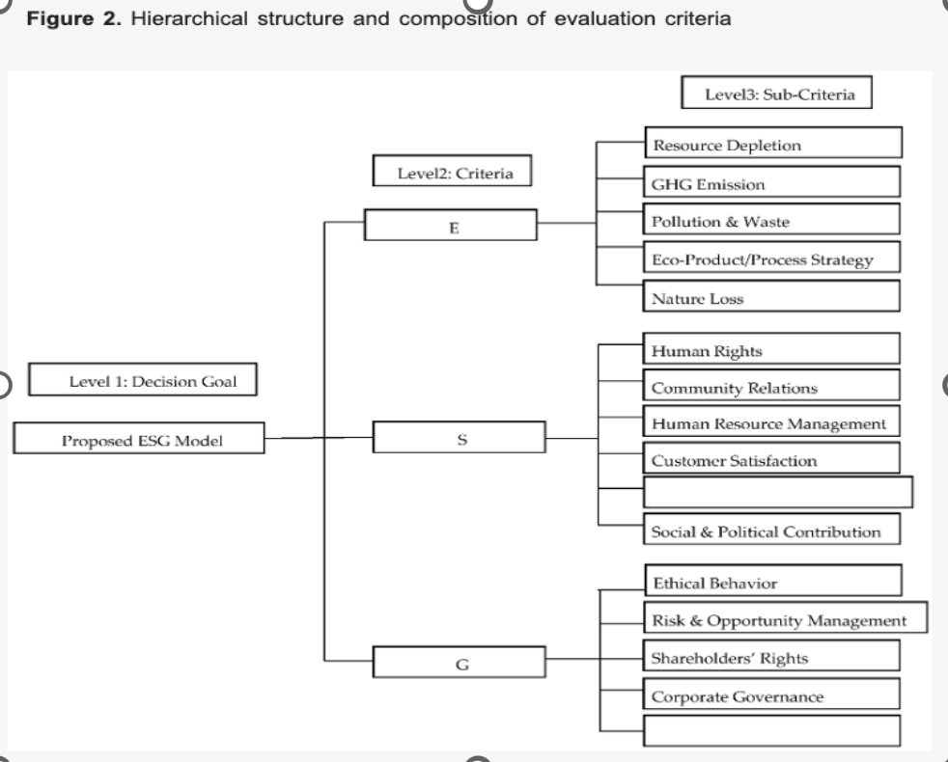
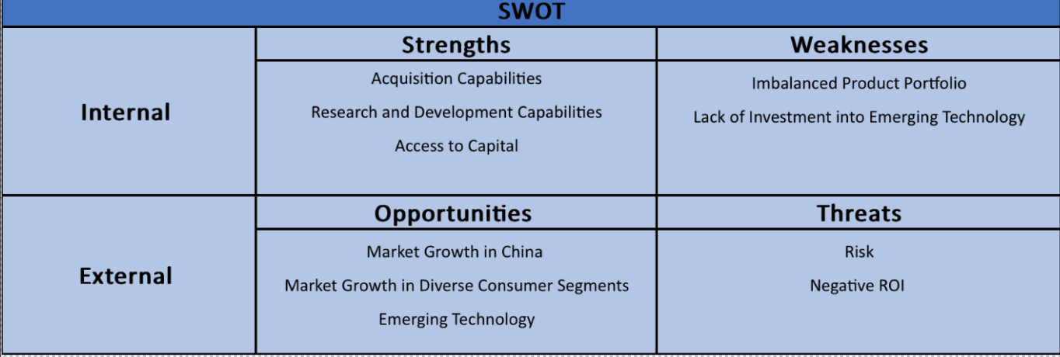
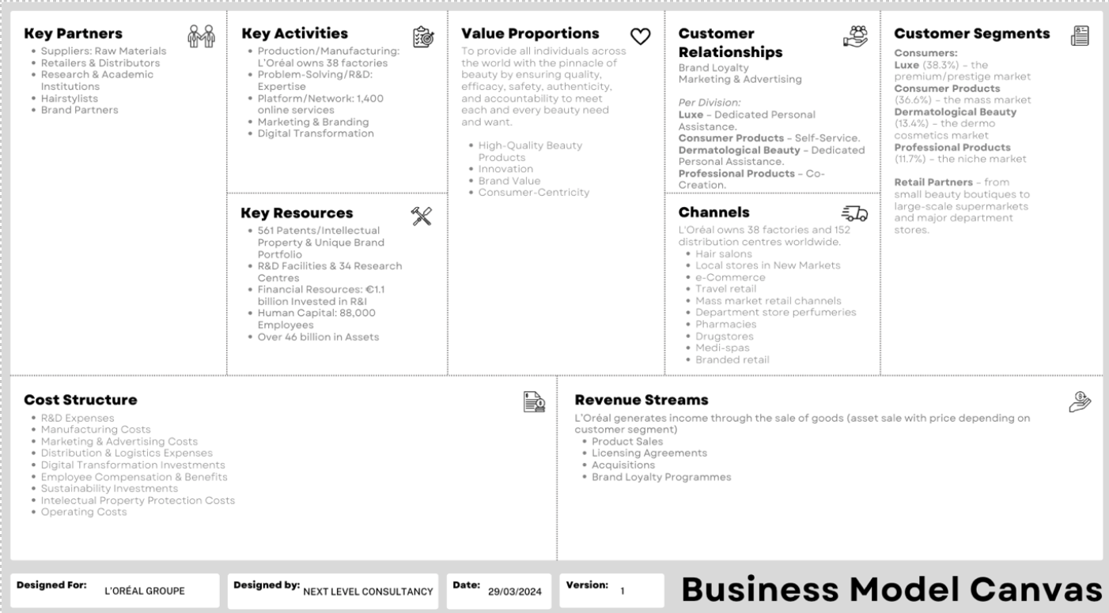
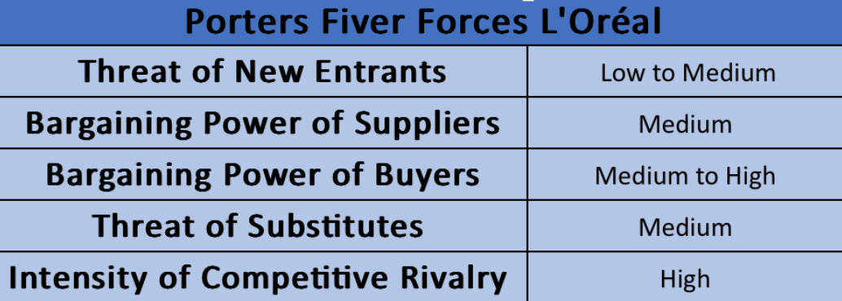
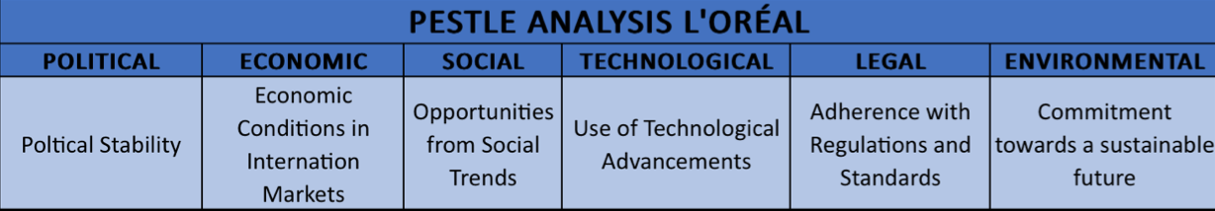
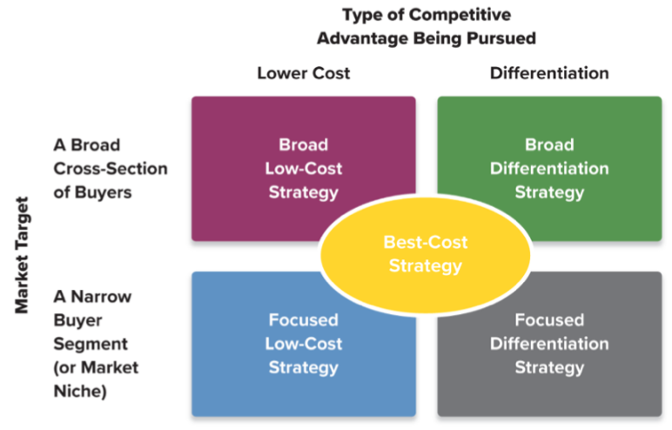
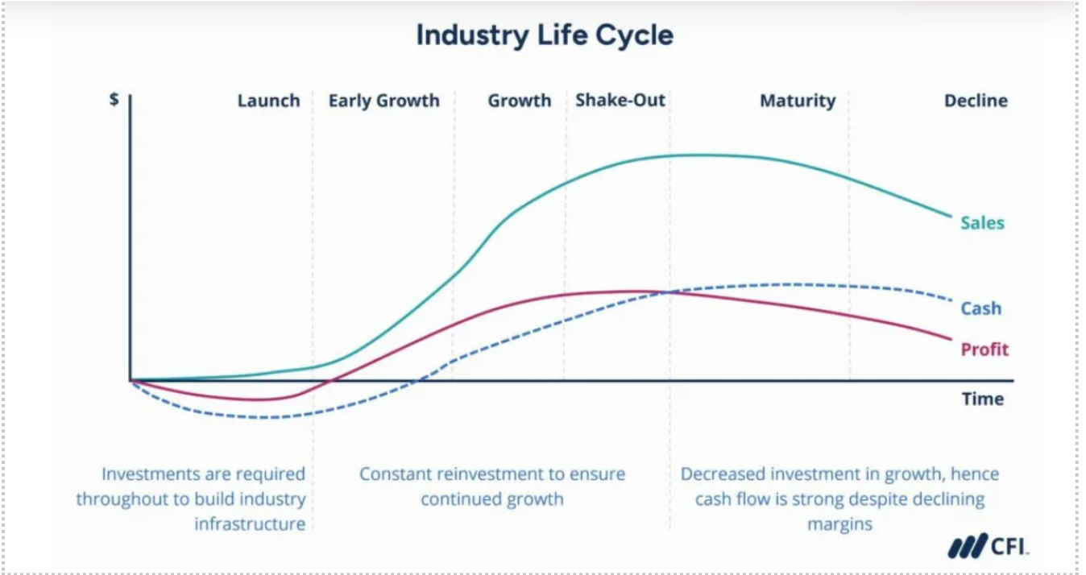
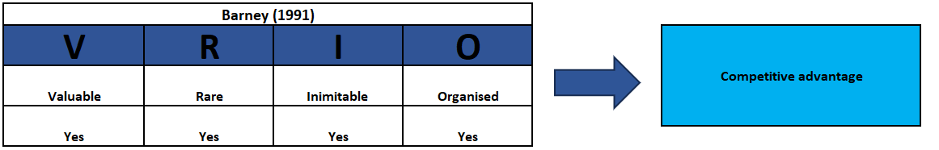
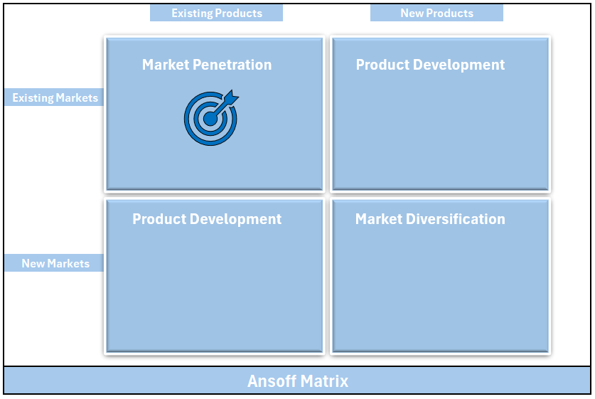
Models
1.
2.
3.
4.
5.
6.
7.
8.
9.

